Slide 1

Women In Movies
Xira Doctor
Thinkful Data Analytics

Slide 2
BUSINESS OBJECTIVE
Examine if there is a significant difference in the budget and profits of films that feature women prominently in the cast and films that do not
Determine whether investing time and money in films that feature women is a wise financial decision

Slide 3
BECHDEL TEST
Two named women characters
They must speak to each other at some point
That conversation is not about a man

Slide 4
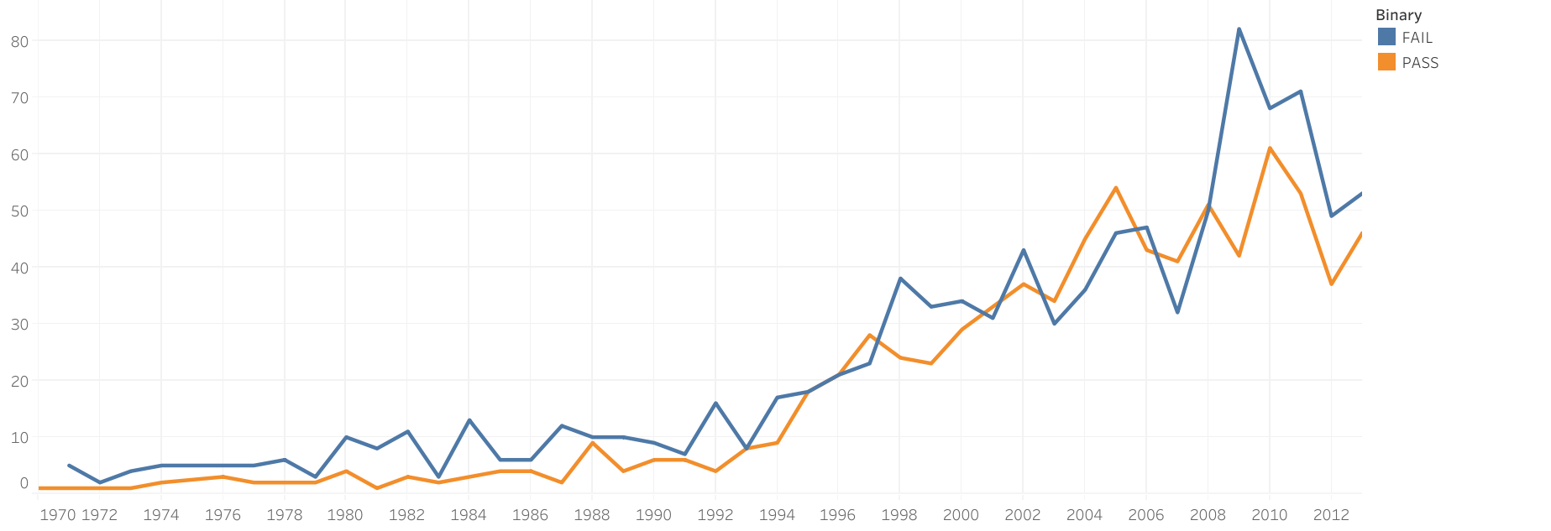
DISTRIBUTION OVER THE YEARS

Slide 5
WHY DO MOVIES FAIL?

Slide 6
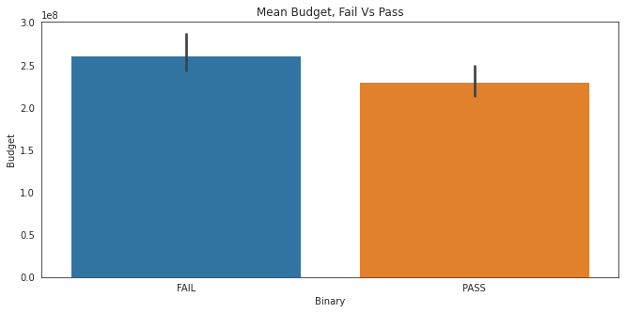
BUDGET: FAIL VS PASS
Based on the
p-value < 0.05, the statistical result shows there is significant difference between the budget of movies that fail the Bechdel test and movies that pass

Slide 7
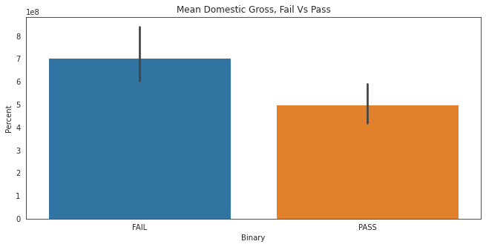
DOMESTIC GROSS: FAIL VS PASS
Based on the
p-value < 0.05, the statistical result shows there is significant difference between the domestic gross of movies that fail the Bechdel test and movies that pass

Slide 8
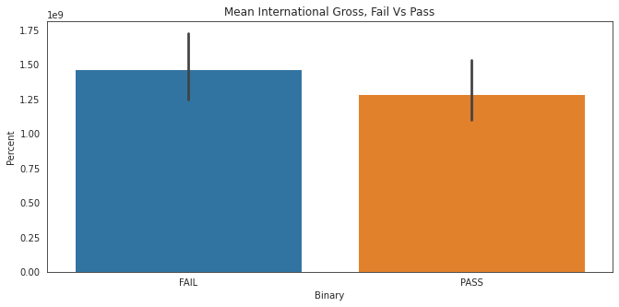
INTERNATIONAL GROSS: FAIL VS PASS
Based on the
p-value > 0.05, the statistical result shows there is NO significant difference between the international gross of movies that fail the Bechdel test and movies that pass

Slide 9

PROFIT: FAIL VS PASS
Based on the
p-value > 0.05, the statistical result shows there is NO significant difference between the profit of movies that fail the Bechdel test and movies that pass

Slide 10
RESULT/RECOMMENDATION
Based on the results of the z-test, significant differences are shown for budget and domestic gross of films that pass and fail the Bechdel test
No significant differences were show for international gross or profit of films that pass and fail the Bechdel test
Studios should be more inclined to produce films that feature more prominent women casts as they have proved profitable

